Slide 1
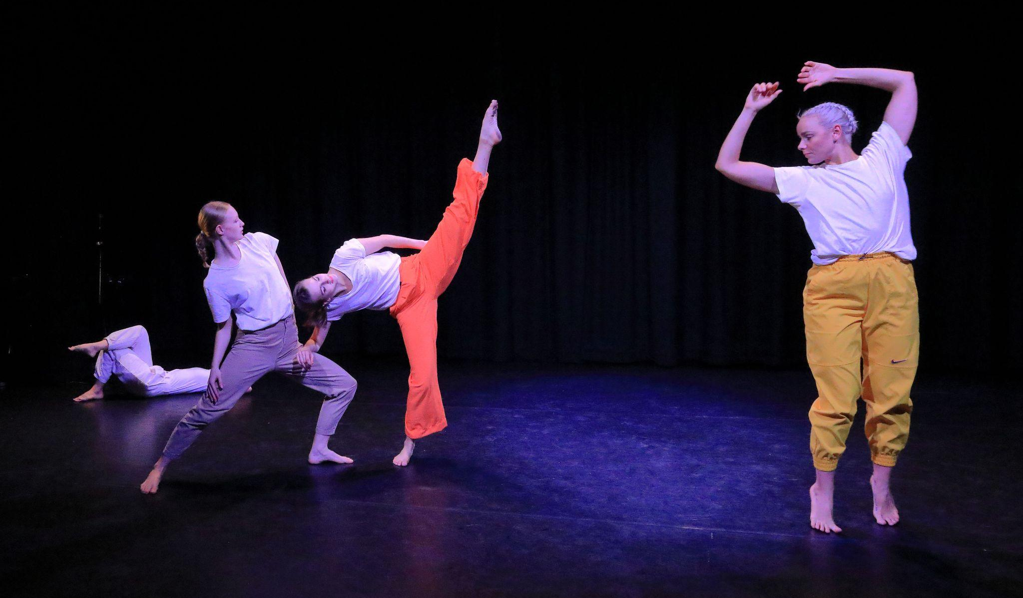
Dew Dance
DEW DANCE
Schools Outreach Programme
Photo by Stu Alsop

Slide 2
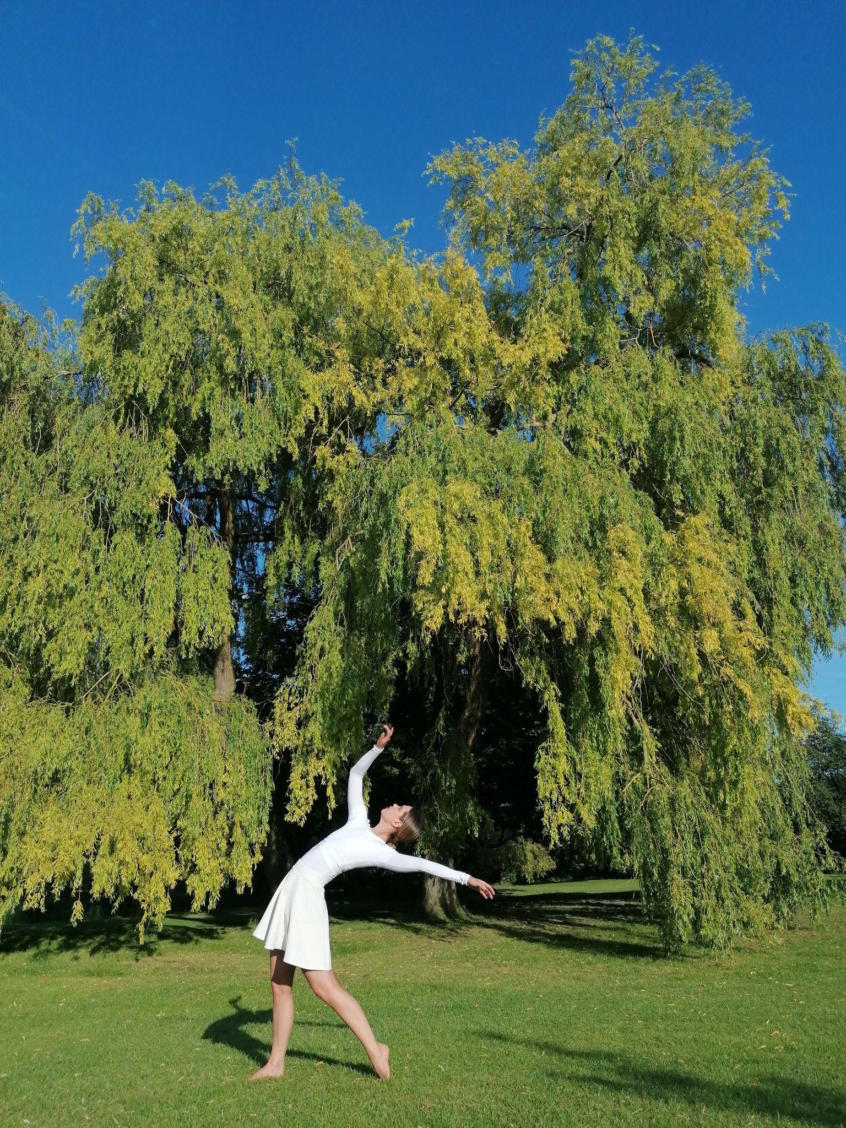
ABOUT US We help schools create meaning and impact through dance storytelling, enriching lives, fostering connection, and inspiring hope in our community and beyond. Dew Dance is a contemporary dance company based in High Wycombe, creating work that resonates deeply and ignites the imagination. We want everyone to experience the transformative power of dance that transcends language. We produce new dance with meaningful messages, deliver workshops, and engage in performance projects with the community. By forming partnerships with local organisations, we build a network that brings together Buckinghamshire artists and residents with a goal is to enrich the local cultural landscape through accessible art, events, and workshops.
Partnered With

Slide 3
Our Schools Outreach Programme We are excited to offer our Schools Outreach Programme, designed to complement and enhance the existing dance curriculum in Schools and Colleges. This programme aims to promote creativity, physical fitness, and community engagement among students, using our latest performance pieces, ‘TRASH’ and ‘Under the Treetops’ as a key elements of the curriculum.
Our Workshops are designed to be: Inclusive: Relevant and achievable for all students, ensuring everyone can participate and benefit. Coherent: Enabling dancers to experience the full spectrum of creating, performing, audience participation, and leading. Purposeful: Providing opportunities for creative and learning work that is meaningful and engaging. Progressive: Gradually developing skills, allowing everyone to reach their potential. Adaptable: Flexible in content, ensuring that workshops can be adjusted in the moment to meet the needs of the participants.
Workshops give participants the opportunity to engage with members of Dew Dance directly and include a contemporary dance technique warm-up, the learning of repertoire and participating in creative process used in the company’s production ‘TRASH’ or ‘Under the Treetops’.

Slide 4
‘TRASH’ Workshop
“TRASH” explores the profound connection between mental wellbeing and environmental destruction. It delves into the relationship between our inner emotional landscapes and the external world, illustrating how personal wellbeing impacts our behavior and the planet and vice versa. TRASH offers students a unique opportunity to engage with contemporary dance while reflecting on important social and environmental issues.
We hope “TRASH” will promote: Dance and Environment: Through creative tasks and the learning of repertoire, students explore the impact of personal wellbeing on environmental health. Choreographic Expression: Students learn and create choreography that represents themes of environmental responsibility and personal wellbeing. Interactive Discussions: Engaging conversations about how our actions affect the planet and what we can do to make a positive impact. Relevance to Curriculum: The workshop links to subjects like Dance, PE, PSHE, English, Drama, Science, and Geography, making the learning relevant and dynamic. Personal and Professional Growth: Students build self-confidence, critical thinking, teamwork, and leadership skills through participation and performance.

Slide 5
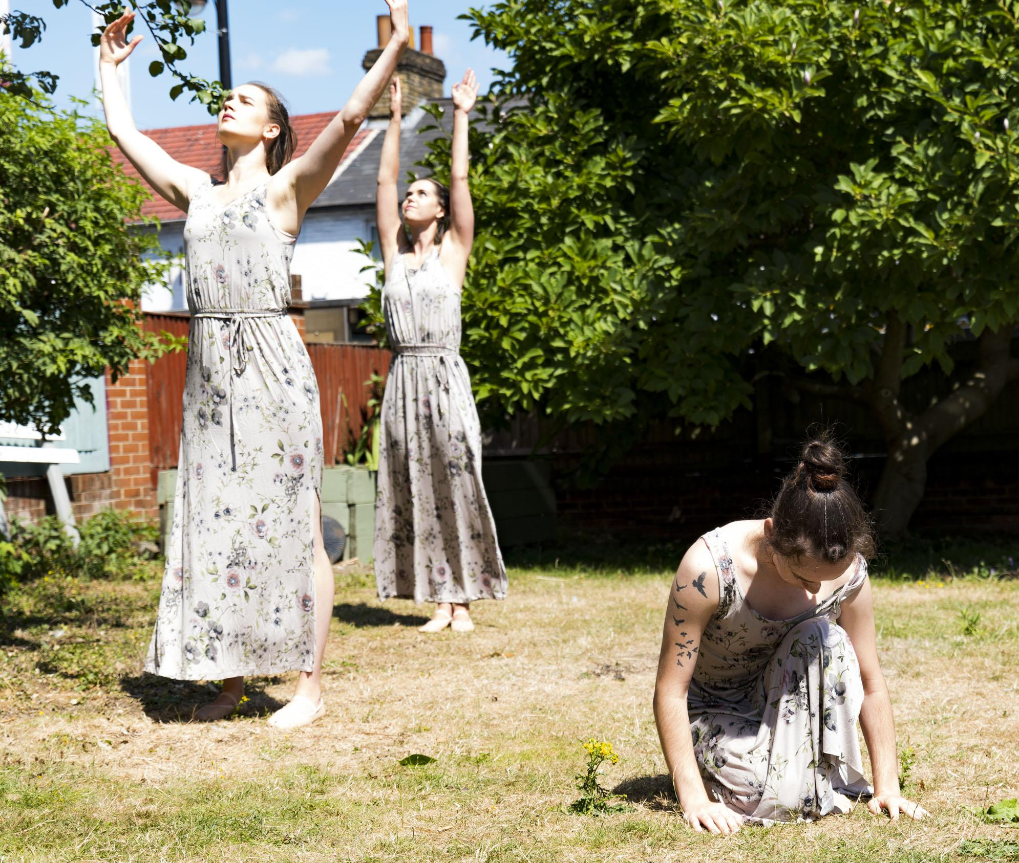
‘Under the Treetops’ Workshop
"Under the Treetops" is an outdoor dance work celebrating nature and the significance of trees, intertwined with stories from the community. The piece explores how trees signify growth, sustain life, and provide shelter. It emphasises the importance of connecting with nature and appreciating its beauty and vitality. The work was originally created as part of Buckinghamshire Culture’s Open Weekend and presented in partnership with Wycombe Arts Centre.​
Highlights of ‘Under the Treetops’:
Connection to Nature: Students engage with themes of nature and community through creative tasks, reflecting on the importance of trees.
Community Stories: Incorporates stories from the local community, making the workshop personal and relatable.
Choreographic Exploration: Students learn and create choreography that embodies the themes of nature, growth, and community, fostering creativity and artistic expression.
Mindfulness and Wellbeing: Encourages mindfulness and wellbeing by connecting with nature and appreciating the environment around them.
Cultural Heritage: Explores the cultural significance of trees in various communities, enhancing students' understanding of different cultural perspectives and traditions related to nature.

Slide 6
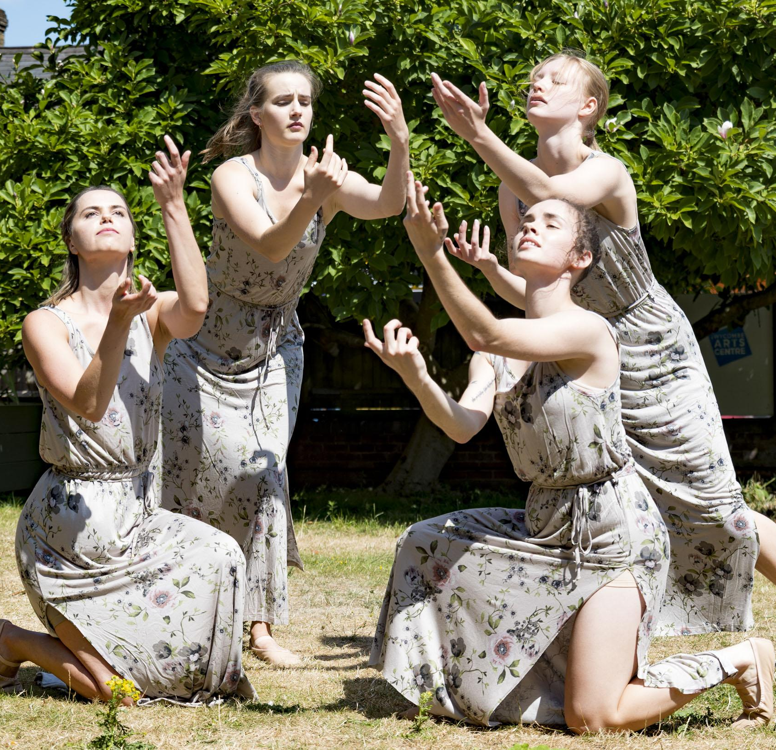
Get Involved!
Partner with Dew Dance to bring this enriching experience to your students. We provide experienced dance teachers, with up to date DBS checks, and all necessary materials for the workshops.
We will deliver our workshops starting from September 2024. Our workshops are available in a variety of structures and start at a negotiable rate of £140.00. The fee also includes a Q&A with the experienced teacher during the session.
Contact
For more information or to schedule our Schools Outreach Programme at your school, please contact:
Dew Dance Email: outreach@dewdance.co.uk Location: High Wycombe, Bucks Website: www.dewdance.co.uk
Photo by Michelle Gerrar

